Slide 1
The Start of the Art Introduction to the Workshop on Crowdsourcing Technologies for Language and Cognition Research
Robert Munro and Hal Tily
Stanford University and MIT

Slide 2
Acknowledgments
University of Colorado & the LSA
David Clausen, Stanford
Crowdflower
Review committee
Presenters
Beth Levin and Tom Wasow

Slide 3
Daily potential language exposure
How many languages could you hear on any given day?
How has this changed?
# of languages
Year

Slide 4
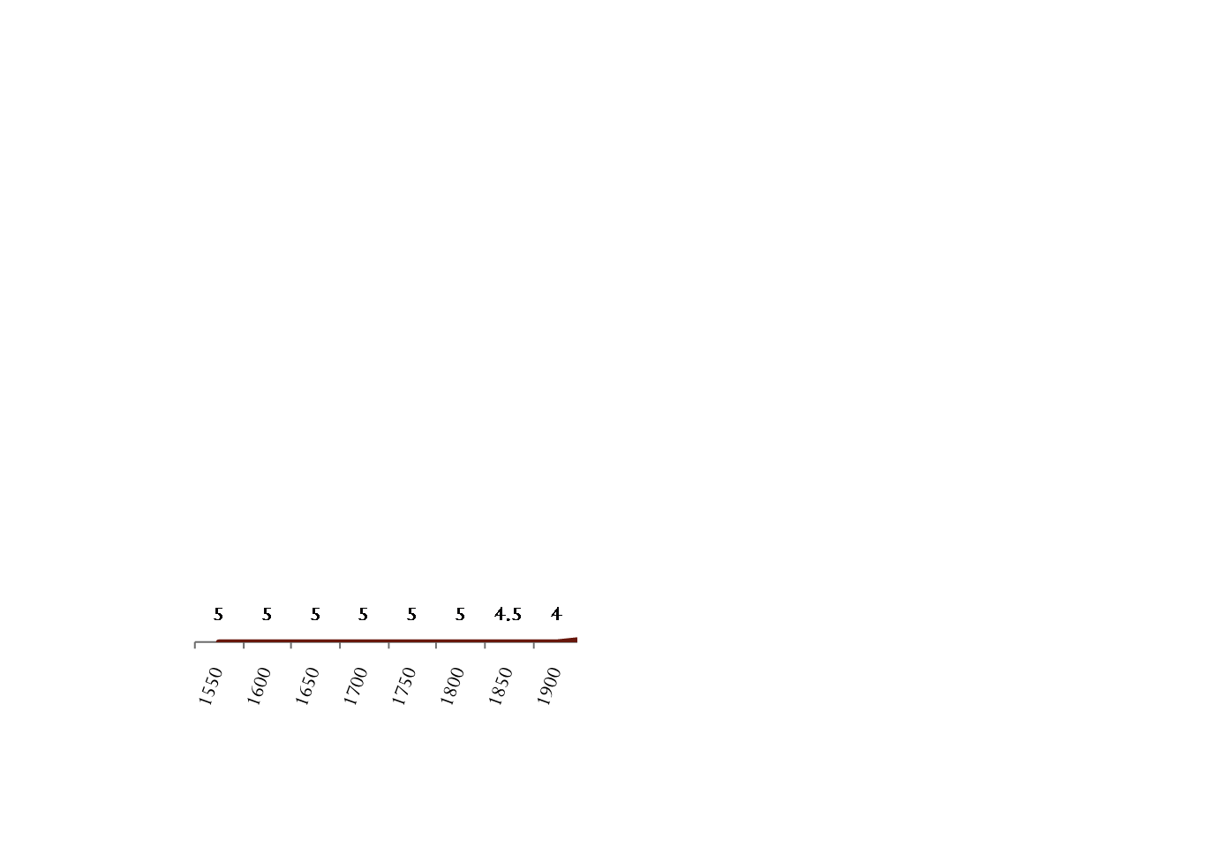
Daily potential language exposure
# of languages
Year

Slide 5
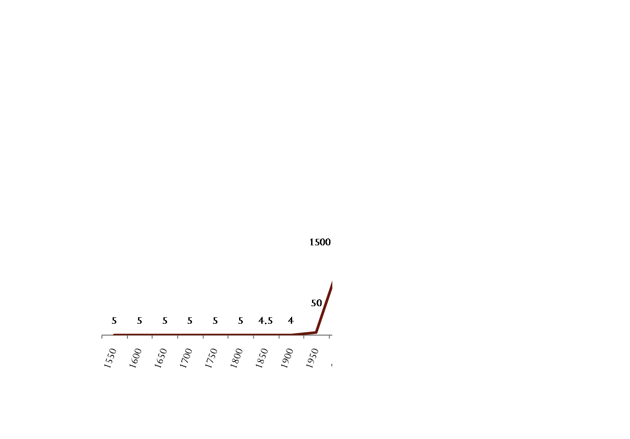
Daily potential language exposure
# of languages
Year

Slide 6
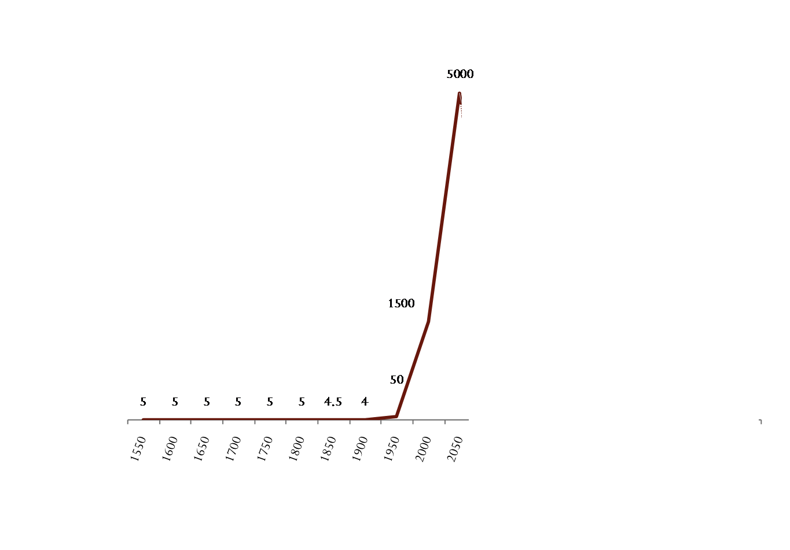
Daily potential language exposure
# of languages
Year

Slide 7
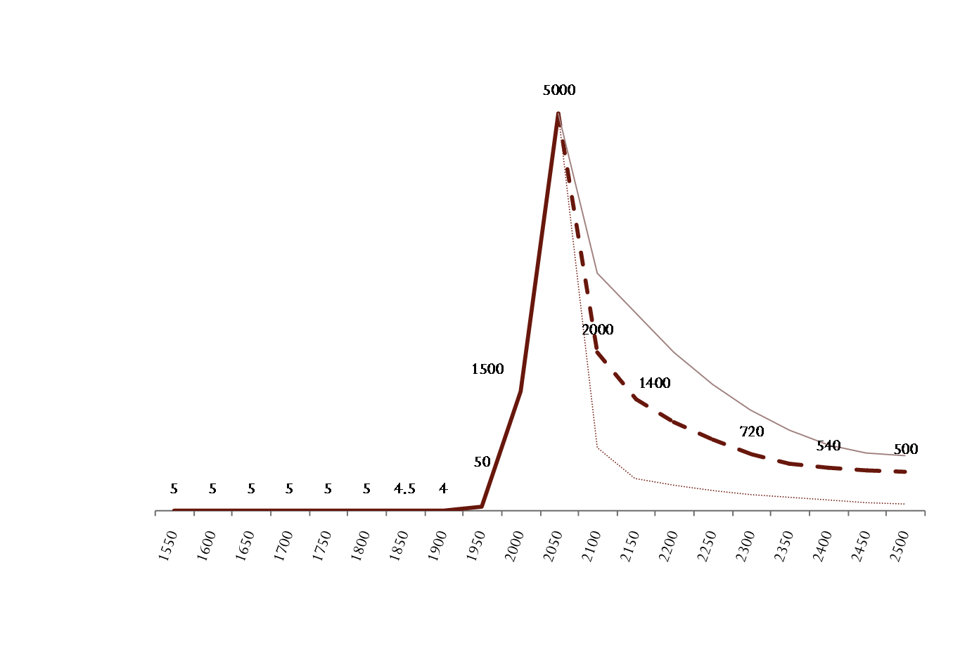
Daily potential language exposure
Our potential communications will never be so diverse as right now
# of languages
Year

Slide 8
Crowdsourcing (microtasking)
People completing short tasks
typically online for a few cents each
Who logs on to complete microtasks?
~1,000,000 people daily
Who can create tasks for workers?
Anyone (on many platforms, Amazon Mechanical Turk from Nov 2005)
What kind of tasks can you create?
Anything embeddable in a browser or phone

Slide 9
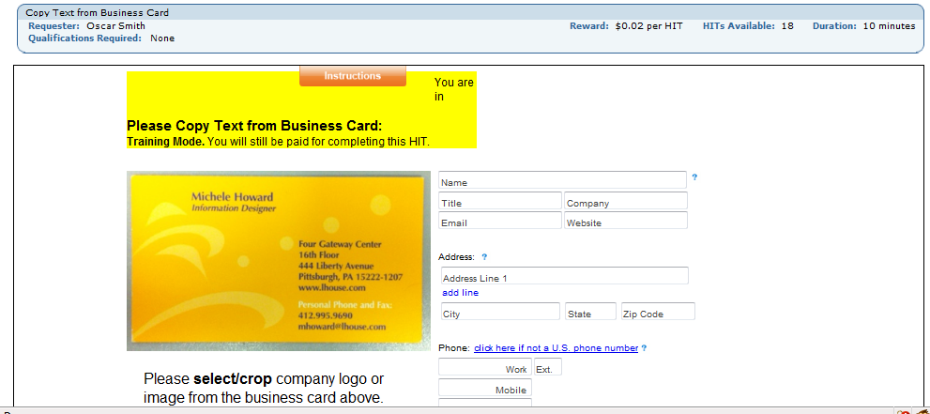
Typical tasks
Transcription of a business card

Slide 10
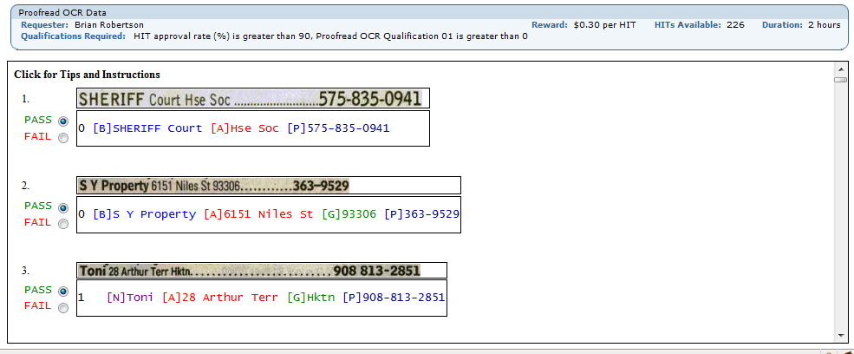
Typical tasks
Quality control for OCR

Slide 11
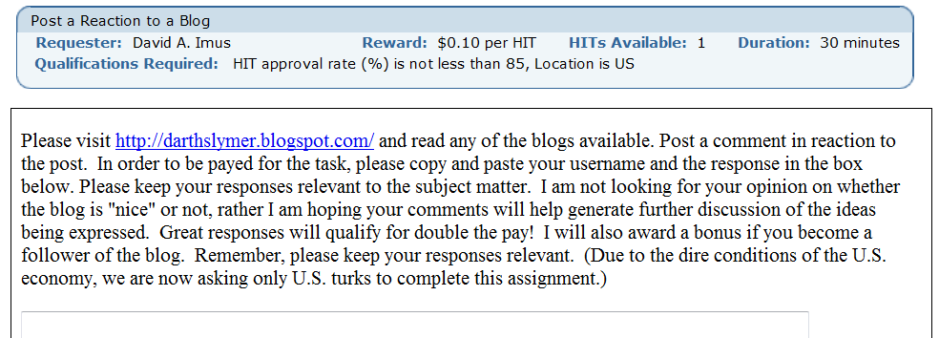
Typical tasks
Write a comment on a blog post

Slide 12
Crowdsourcing and language
Powerset (2007~8)
Semantic annotation (Snow et al. 2008)
Linguistic research (Munro et al. 2010)
Quality control across multiple worker platforms (CrowdFlower)

Slide 13
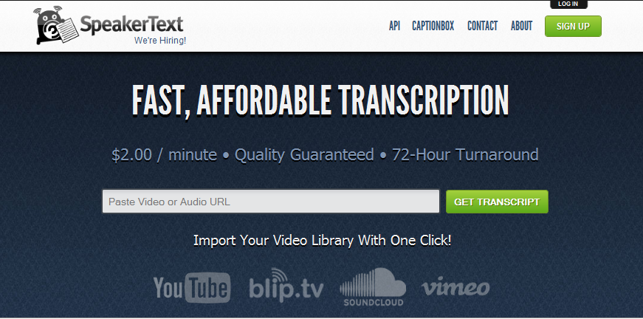
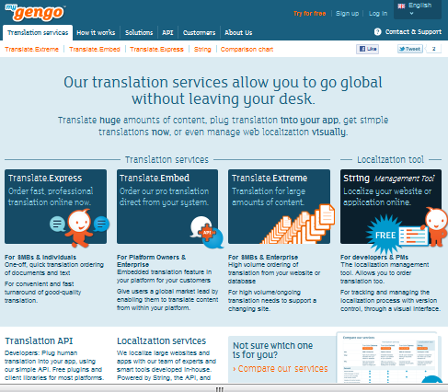
Crowdsourcing and language
Commercial transcription and translation

Slide 14
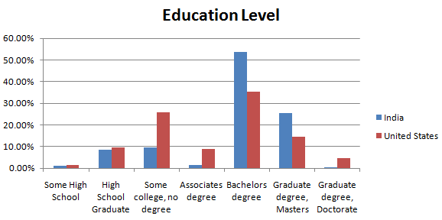
Who are the workers?
(source: http://behind-the-enemy-lines.blogspot.com/2010/03/new-demographics-of-mechanical-turk.html)

Slide 15
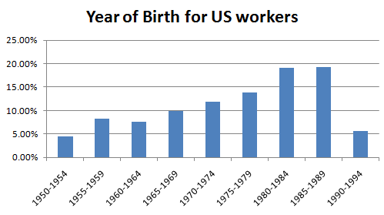
Who are the workers?
(source: http://behind-the-enemy-lines.blogspot.com/2010/03/new-demographics-of-mechanical-turk.html)

Slide 16
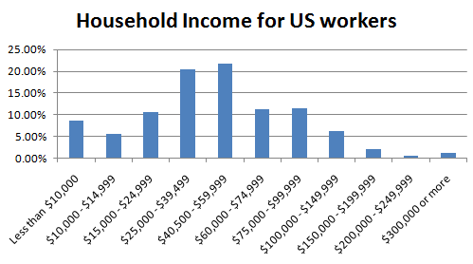
Who are the workers?
(source: http://behind-the-enemy-lines.blogspot.com/2010/03/new-demographics-of-mechanical-turk.html)

Slide 17
Who are the workers?
(source: http://behind-the-enemy-lines.blogspot.com/2010/03/new-demographics-of-mechanical-turk.html)

Slide 18
Who are the workers?
(source: http://behind-the-enemy-lines.blogspot.com/2010/03/new-demographics-of-mechanical-turk.html)

Slide 19
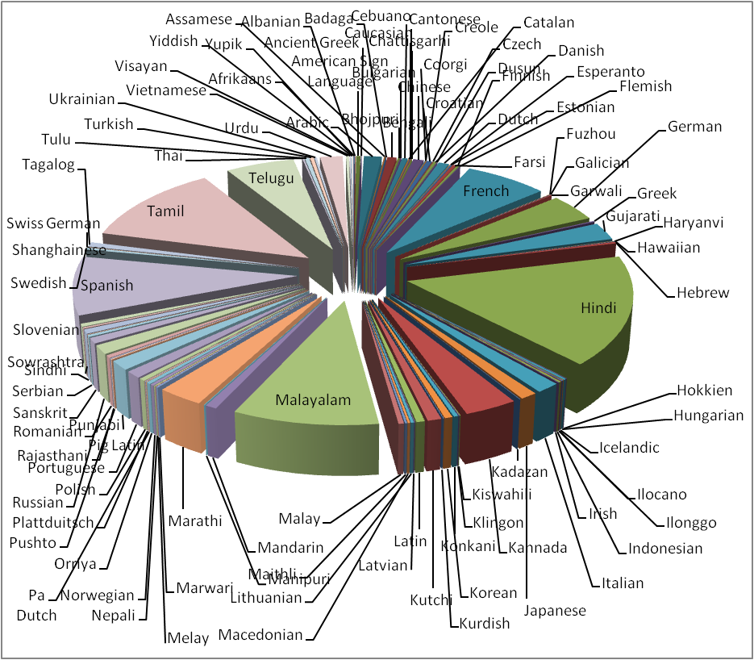
What languages do they speak?

Slide 20
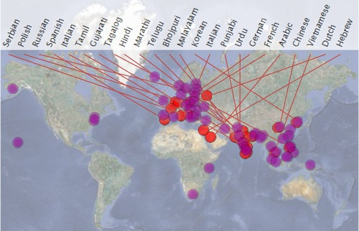
What languages do they speak?

Slide 21
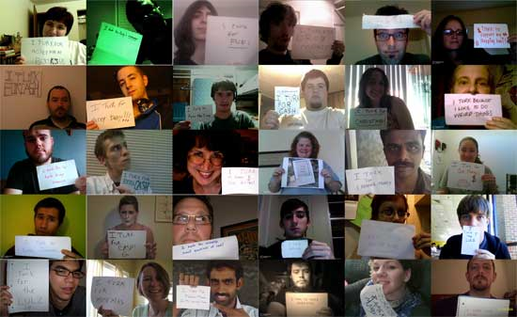
Why people work
(source: http://waxy.org/2008/11/the_faces_of_mechanical_turk/)

Slide 22
Crowdsourcing and language

Slide 23
Crowdsourcing and research

Slide 24
Will people enjoy language tasks?
“It’s really nice to remind me what I am”
“I am hoping that MTurk will provide more opportunities for translations in Spanish!”
“What about localizing mturk in different languages so that any one can easily work in mturk”
“It is a very enjoyable thing to do research in linguistics.”
“I’m an outlier, because I love languages so much, but you can count me in, I suppose. Good luck with your research.”
“Used to be fluent in Latin, but it’s hard to stay in practice with a dead language.”
“Tamil is my mother tongue ... the creativity will shine in mother tongue only.”
“This is not only work. It can improve our knowledge also”

Slide 25
Language and cognition research
Cultural transmission of grammatical structure: Introducing a web-based iterated language learning paradigm with human participants
Jaeger, Tily, Frank, Gutman and Watts
Assessing the pragmatics of experiments with crowdsourcing: The case of scalar implicature
Anand, Andrews and Wagers
Collecting task-oriented dialogues
Clausen and Potts
Trivial Classiﬁcation: What features do humans use for classiﬁcation?
Boyd-Graber
Language Learning
Pragmatics
Dialogue
Intuition

Slide 26
Language and cognition research
A crowdsourcing study of logical metonymy
Zarcone and Pado
Balancing experimental lists without sacrificing voluntary participation
Watts and Jaeger
Creating illusory social connectivity in Amazon Mechanical Turk
Duran and Dale,
A case study in eﬀectively crowdsourcing long tasks with novel categories
de Marneffe and Potts
Semantics
Balancing experiments
Controlling social context
Running large studies

Slide 27
“Arm-chair” linguist
Circa1950-2000

Slide 28
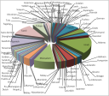
“Arm-chair” linguist
Circa 2010+

